Slide 1
How to get your Students to Prepare for Every Class
Just-in-Time Teaching (JiTT)
A. Gavrin, IUPUI
http://webphysics.iupui.edu/nfw_summer15/index.html
Notes:
55 people completed the warmup! How many looked at the material?
Remark on web site, especially resources

Slide 2
A few of your comments
Jeremy: Practical examples of how to deal with 150-ish students in this manner would be appreciated.
SuperNerd: I would like to see some concrete examples …
Data: It would be interesting to have some practical information about how to formulate good warmup exercises, and also how to use them during lectures
Christine: I'd like to see a variety of concrete examples of pre-class assignments...
Notes:
and MANY more requests for specific details, motivating students, etc.

Slide 3
Outline
Introduction
Just-in-Time Teaching
  Background
  Implementation
  Aside: How to get great student evaluations
Assessment
Getting started

Slide 4
How did you decide how to teach?
Steve: I try to replicate and improve the practices of the teachers who I thought taught me the most/best.
Baba: Mostly based on how my favorite professors taught me when I was a student…
lgua: Based on what worked well for me when I was a student.
Zoe: The two primary ways I have decided how to teach are by: (1) following the examples of role models and (2) trial and error.

Slide 5
Danger of using “own experience”
Classes designed for professors or “pre-professors”
Problem: Students do not learn like we do
  Not motivated to be experts
  Need more time to think
  Not as good at working alone
  Not as good at judging their own performance
  Many under greater pressure
See R. Felder references on web site
Notes:
Can’t emphasize this enough… You are just not typical.
What are the alternatives?

Slide 6
How Else?
K.S. I model my classes after my own favorite teachers in college and grad school… To a lesser extent I have applied information learned in the handful of education classes…
Jeremy: Workshops, talking to colleagues, reading education literature, intuition based on my own experiences, trial and error.

Slide 7
Digression
Could have spent time “collecting data”
Instead, spent time discussing it
Same content covered at greater depth

Slide 8
One solution: Active learning
Proven effective for “regular” students and excellent ones
Used extensively at MIT, RPI, Harvard, Univ. of Illinois, other research universities
Also many small colleges (prestigious and not), community colleges, K-12 schools…
Close to “apprenticeship” or relationship between PhD student and advisor

Slide 9
Outline
Introduction ✓
Just-in-Time Teaching
  Background
  Implementation
  Aside: How to get great student evaluations
Assessment
Getting started

Slide 10
The (original) settings
IUPUI: Public, urban university
  30,000 students, almost 100% live off campus
  Most work > 25 hours/week
United States Air Force Academy: Military
  All students take physics, even history majors
  All play sports, train for military
Davidson College: Liberal arts college
  Highly selective
  Small classes

Slide 11
What is JiTT?
Nathaniel : JiTT is the process of assessing students' knowledge of a topic prior to class so that class time can most efficiently…
Stella: JITT is assigning work to be done before class, where the instructor can see student responses and adapt their own teaching to address problem concepts or reduce coverage of “easier” material in class.
Notes:
Just TONS of great responses. Everyone gets the basics, despite the many excellent questions.

Slide 12
What is JiTT?
Mike D: JiTT is both a way to get the students thinking about the material before class and also a way for the instructor to get feedback on how well students understand the material before choosing which topics to emphasize.
Parashu: …This strategy aims to develop interest in the subject matter to be taught which will finally lead to higher percentage of student attendance, retention and good grade.

Slide 13
What is JiTT?
YaYa: ….could also trigger a good interaction and conversation in the classroom while discussing different responses.
Nathan: The instructor then uses these questions to inform class discussion, assess the level of student understanding, and increasing buy-in by the students by starting an interaction with them through directly quoting student answers in class.

Slide 14
What is important about JiTT?
assessing students' knowledge
adapt their own teaching
get the students thinking about the material
develop interest in the subject matter
higher percentage of student attendance
interaction and conversation in the classroom
directly quoting student answers

Slide 15
Just-in-Time Teaching (JiTT)
World Wide
Web
Homework
Classroom
Assignment
Design

Slide 16
Just-in-Time Teaching
Adaptable
Combines “high tech” with “high touch”
WarmUp Exercises = Online, pre-class reading quiz:
  Due few hours before class
  A few open-ended conceptual questions
  Cover that day’s material

Slide 17
Another Digression
JiTT described in your words
“preview” of important concepts
Jargon already familiar (JiTT, Warmup)
Big idea (connect class to HW) already present

Slide 18
Example
Question: Is it possible to add heat to an ideal gas without changing its temperature? If it is possible, please explain how it is done.
  “It is not possible because the internal energy of an ideal gas only depends on the temperature.... the internal energy will increase when the temperature rises.…”
  “If you add heat to a system while the system is doing the corresponding amount of work, the temperature will not change.”
  “It is possible to add heat to an ideal gas without it changing it‘s temperature by the gas receiving the heat, and the atoms of that gas getting excited enough to disperse that heat as fast as they receive it…”

Slide 19
What makes a good Warmup?
Adam: The student should be forced to examine their present understanding, and potentially address conceptual change. The assignment should provide them with a high motivation for understanding the material.
Bill Bobaggins: A good warmup exercise is to ask a conceptual question about the material for the next class such as explain in words what Newton's third law says.

Slide 20
What makes a good WarmUp?
Nick: A good warmup exercise is thought provoking, open-ended and sometimes ambiguous. I would add that the exercises should indicate a direction for class activities that make class time more student centered and optimize class time engagement.

Slide 21
Online archive of Warmup exercises
http://webphysics.iupui.edu/warmup/physics_archive.html
Introductory physics (2 semester sequence)
Statistical/Thermal Physics (2 sets)
Intermediate Mechanics (2 sets)
Modern Physics, Quantum Mechanics
Intermediate E&M (2 semester sequence)
Mathematical Methods
Optics, Intro Astronomy
Needed: Condensed matter, other specialties…

Slide 22
Choosing and using student responses
Always say something positive (see last example)
  This is true, but what if something else occurs simultaneously…
  This makes sense, but something is missing…
  This is a great response… how would we know how much heat to add?
  This is correct, but the reasoning isn’t quite right…
  This has a great beginning, but more could be added…

Slide 23
Tips and Pitfalls
Explain methods and purpose on first day
No need to review all responses before class; sample for “useful” quotes, grade later
Focus on students strengths, too, not just misconceptions and other problems.
Use answers from many students: not favorites.
Do not “isolate” warmups – use throughout session
Must be routine. Do not start/stop during semester
Upper level students can handle more “exploratory” questions, connections to prerequisites
Faculty cedes some control!

Slide 24
Results
Students better prepared for class
  Familiar with jargon
  Given thought to ideas
Faculty better prepared for students
  Misconceptions identified
  Just in time adjustment to coverage
Class time spent more productively
  Students interact during class

Slide 25
How to get great student evaluations
First five minutes are critical!
Be a leader—college is hard, and students look to you for motivation, don’t disappoint them.
Build a team—let students know that you and they are working towards a common goal.
Earn trust—take time on the first day of class to explain what you are doing and why.
Hold yourself and your students to high standards—if you work hard, they will too.

Slide 26
Outline
The Challenges ✓
Just-in-Time Teaching ✓
  Background ✓
  implementation ✓
  Aside: How to get great student evaluations ✓
Assessment
Getting started

Slide 27
Study Habits (N=155, biology)
Q1 Do the WarmUps help you stay caught up?
Q2 Do you “Cram” before tests in this course?
Q3 Do you “Cram” in your other courses?
 | 1- Yes | 2- Yes | 3- Yes
“A” students | 85% | 14% | 43%
“B” students | 89 % | 39% | 61%
“C” students | 89% | 47% | 68%
“D” students | 84% | 68% | 68%
“F” students | 92% | 58% | 58%

Slide 28
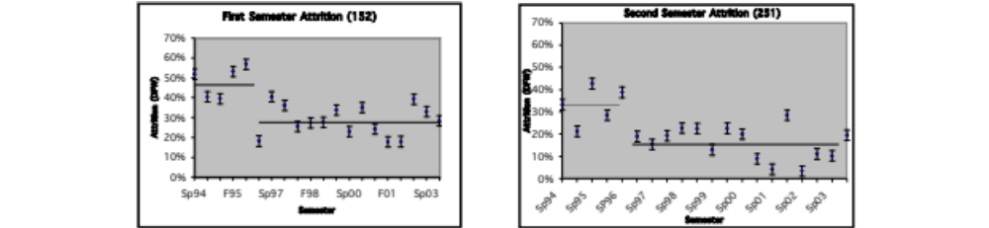
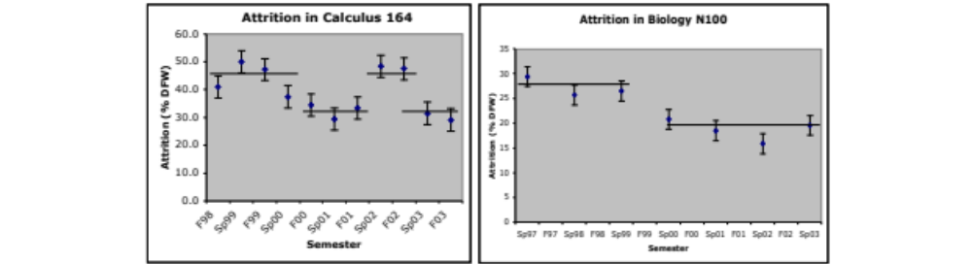
Retention (N~80-150/semester)

Slide 29
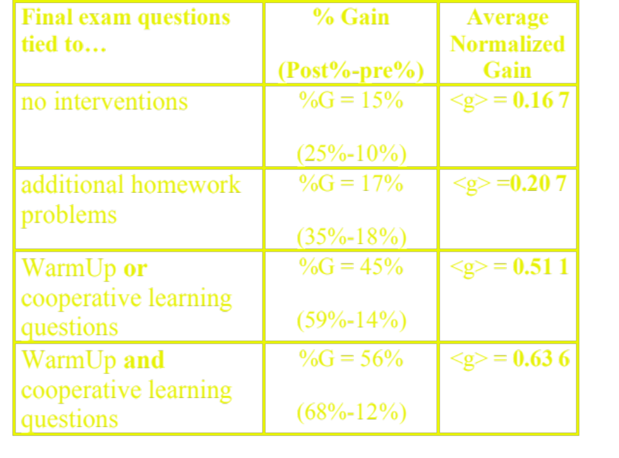
Cognitive (biology, N~200)

Slide 30

Affective (E&M, N~60)

Slide 31
Student Comments
“This was a fantastic course. It was the hardest course I’ve taken yet, but also the most fun.”
I think the WarmUps are a good idea because they give students a chance to think about the material prior to lecture.
"This course was very well structured. It was obvious that a lot of time was spent in preparation for it.”
"152 & 251 have made me reach more than any courses I have taken.”
Don’t tell anyone, but I think I will greatly miss my physics class.

Slide 32
Summary
JiTT is based on feedback between homework and classroom
WarmUp exercise: a pre-class, online reading quiz
Improved study habits, retention, content knowledge, morale.
Instructor knowledge of student difficulties
Easily adopted and adapted

Slide 33
Outline
The Challenges ✓
Just-in-Time Teaching ✓
  Background ✓
  implementation ✓
  Aside: How to get great student evaluations ✓
Assessment ✓
Getting started

Slide 34
Getting started:
Write one question, to be part of one assignment, right now!
Later, use the handout to start developing a warmup exercise for the course you are most likely to teach next fall.

Slide 36
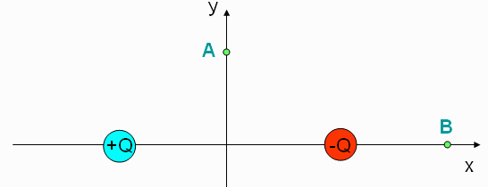
smartPhysics checkpoint
1. Two equal, but opposite charges are placed on the x axis. The positive charge is placed at to the left of the origin and the negative charge is placed to the right, as shown in the figure. What is the direction of the electric field at point A?
a) up b) down c) left d) right e) zero
2. Explain your reasoning

Slide 37
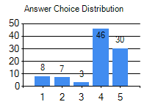
smartPhysics output
Aaron (aaron@iupui.edu)
1) 4
2) the field from Q+ points up and to the right, while Q- points down and to the right therefore when adding them together it points to the right.
Beatrice (beatrice@iupui.edu)
1) 4
2) point A is equidistant from each charge and they would therefore cancel out
Ada (ada@iupui.edu)
1) 2
2) The charges will cancel out so the direction of the force will be down
Ahmed (ahmed@imail.iu.edu)
1) 4
2) the field is toward the negative charge and away from the positive charge which makes the direction to the right

Slide 38
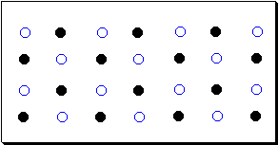
Chemistry example
This picture depicts matter at the submicroscopic level. Describe what you see and take a guess as to what the identity of the substance is.
  “The particles are well spaced out so I would guess the substance to be a gas. The substance is a gas composed of 2 elements that are in an equal ratio.”
  “After reading Chapter 1 in the book I would guess that the substance is water in the form of a solid because the atoms are in order. However, I could be wrong because I think the atoms in a solid might be closer together.”

