Slide 1
How to get your Students to Prepare for Every Class
Just-in-Time Teaching (JiTT)
A. Gavrin, IUPUI
http://webphysics.iupui.edu/efw_april13/index.html

Slide 2
A few of your comments
Bass1: Instead of just asking me to "go read about JITT", this exercise helped to guide my reading and get me thinking about the applications of JITT in the classroom.
JumpingJack: Doing this sounds exhausting, and unlikely to be appreciated by the students…. It is a good idea, but not one that I would find easy to implement.
quincy: my experience with JiTT is that my "warm ups" are either too easy or too difficult…. I need some help in clearly understanding how to construct warm ups.

Slide 3
Outline
Introduction
Just-in-Time Teaching
  “Theory”
  Implementation
  Aside: How to get great student evaluations
Assessment
Getting started
Notes:
Remark on web site, especially resources

Slide 4
When you plan to teach a course what influences your thinking?
#1 Experience as a student
#2 Discussions with colleagues.
Some PER, publisher materials, other

Slide 5
Examples
oropendola: I try to remember what topics were difficult for me to learn…
Michael: My experience as a student is useful for me to measure the minimum coverage…
Marco: …I discuss the [book] selection process with the previous instructor. So after reviewing what material is expected to be covered by the University i look at the previously selected text…
Commonalities? Problems?

Slide 6
Counterexamples
snipe: Recently I have been trying to introduce into my classes, various techniques I have read about in the PER literature. …
physics 113: I am amazed that "interaction with students" is not on the list---whether from graduate, undergraduate, or as a professor. Most of what I learn about how to teach is from my students.

Slide 7
Problem:
Classes designed for professors or “pre-professors”
Students do not learn like we do
  Not motivated to be experts
  Need more time to think
  Not as good at working alone
  Not as good at judging their own performance
  Many under greater pressure
Interesting work by Richard Felder (NCSU, Chem Eng.)

Slide 8
Digression
Could have spent time “collecting data”
Instead, spent time discussing it
Same content covered at greater depth

Slide 9
Outline
Introduction ✓
Just-in-Time Teaching
  Background
  Implementation
  Aside: How to get great student evaluations
Assessment
Getting started

Slide 10
The “theoretical” background
Active learning (students think in class)
Student centered (it is not about you)
Formative assessment (real-time feedback)
Peer interaction (learning and motivation)
Many learning styles (faculty not like students)

Slide 11
JiTT (and other active learning)
Proven effective for “regular” students and excellent ones
  Anyone not a likely future professor
Used extensively at MIT, RPI, Harvard, Univ. of Illinois, other research universities
Also many small colleges (prestigious and not), Community Colleges, high schools
Introductory, upper division, graduate
ADAPT!

Slide 12
What is JiTT?
Cello: Method to make class more responsive to students needs, and to encourage students to be better prepared for class, via pre-class assignments
Oliver: Having the students interact with the course material you will be covering, and answer questions based upon that material well before class begins.
Bob: Enhancing the learning experience for students by engaging them in exercises that require them to think before entering the classroom.
Dr. B. JiTT is a feedback loop … The goal is to maximize student engagement and learning during a face-to-face class meeting.

Slide 13
Just-in-Time Teaching (JiTT)
World Wide
Web
Homework
Classroom
Assignment
Design

Slide 14
Just-in-Time Teaching
Adaptable
Combines “high tech” with “high touch”
WarmUp Exercises = Online, pre-class reading quiz:
  Due few hours before class
  A few open-ended conceptual questions
  Cover that day’s material

Slide 15
Another Digression
JiTT described in your words
Jargon already familiar (JiTT, WarmUp)
“preview” of important concepts

Slide 16
The “Interactive Lecture”
Step 1: Synchronization
Read (some of) the students’ responses…
What do they understand?
Step 2: Preparation
Select excerpts from students work, adjust clicker questions, etc.
Step 3: Execution
Class is a dialog based on student excerpts and faculty notes

Slide 17
Example
Question: Is it possible to add heat to an ideal gas without changing its temperature? If it is possible, please explain how it is done.
  “It is not possible because the internal energy of an ideal gas only depends on the temperature.... the internal energy will increase when the temperature rises.…”
  “It is possible to add heat to an ideal gas without it changing it's temperature by the gas receiving the heat, and the atoms of that gas getting excited enough to disperse that heat as fast as they receive it…”
  “If you add heat to a system while the system is doing the corresponding amount of work, the temperature will not change.”

Slide 18
Choosing and using student responses
Always say something positive
  This is true, but what if something else occurs simultaneously…
  This makes sense, but something is missing…
  This is a great response… how would we know how much heat to add?
More useful phrases…
  This is a good answer, but to a different question…
  This has a great beginning, but more could be added…
  This is correct, but the reasoning isn’t quite right…

Slide 19
Tips and Pitfalls
Explain methods and purpose on first day
No need to review all responses before class; sample for “useful” quotes, grade later
Focus on students strengths, too, not just misconceptions and other problems.
Use answers from many students: not favorites.
Do not “isolate” WarmUps - scaffold lecture
Must be routine. Do not start/stop during semester
Upper level students can handle more “exploratory” questions, connections to intro.

Slide 20
What makes a good WarmUp?
king: A good "warmup exercise" lets a student motivate and think for the upcoming lecture on that topic. It is like the "spark-plug" in a car.
JD: …One that connects directly to the main goals, new notations, and possible missconceptions in the upcoming material
Tycho:… those that test the student's understanding and those that stimulate class discussion and are typically more open ended.

Slide 21
Online archive of Warmup exercises
http://webphysics.iupui.edu/warmup/physics_archive.html
Introductory physics (2 semester sequence)
Statistical/Thermal Physics (2 sets)
Intermediate Mechanics (2 sets)
Quantum Mechanics
Mathematical Methods
Intermediate E&M (2 semester sequence)
Introductory Astronomy
Modern Physics (coming soon)

Slide 22
smartPhysics
http://www.smartphysics.com/smartphysics/default.aspx
Calculus-based Mechanics, E&M
Pre-lecture videos (~15min/class)
Small, paperback text
Integrated homework, “checkpoints”
Authored at UIUC by Gladding, Stelzer, Selen
Published by W. H. Freeman
~$40/semester

Slide 23
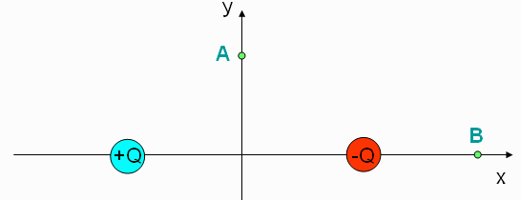
smartPhysics checkpoint
1. Two equal, but opposite charges are placed on the x axis. The positive charge is placed at to the left of the origin and the negative charge is placed to the right, as shown in the figure. What is the direction of the electric field at point A?
a) up b) down c) left d) right e) zero
2. Explain your reasoning

Slide 24
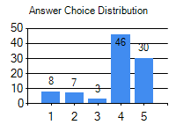
smartPhysics output
Aaron (aaron@iupui.edu)
1) 4
2) the field from Q+ points up and to the right, while Q- points down and to the right therefore when adding them together it points to the right.
Beatrice (beatrice@iupui.edu)
1) 4
2) point A is equidistant from each charge and they would therefore cancel out
Ada (ada@iupui.edu)
1) 2
2) The charges will cancel out so the direction of the force will be down
Ahmed (ahmed@imail.iu.edu)
1) 4
2) the field is toward the negative charge and away from the positive charge which makes the direction to the right

Slide 25
Results
Students better prepared for class
  Familiar with jargon
  Given thought to ideas
Faculty better prepared for students
  Misconceptions identified
  Just in time adjustment to coverage
Class time spent more productively
  Students interact during class

Slide 26
How to get great student evaluations
First five minutes are critical!
Be honest, and direct—take time on the first day of class to explain what you are doing and why.
Be a leader—college is hard, and students look to you for motivation, don’t disappoint them.
Build a team—let students know that you and they are working towards a common goal.
Hold yourself and your students to high standards—if you work hard, they will too.

Slide 27
Outline
The Challenges ✓
Just-in-Time Teaching ✓
  Background ✓
  implementation ✓
  Aside: How to get great student evaluations ✓
Assessment
Getting started

Slide 28
Study Habits (N=155, biology)
Q1 Do the WarmUps help you stay caught up?
Q2 Do you “Cram” before tests in this course?
Q3 Do you “Cram” in your other courses?
 | 1- Yes | 2- Yes | 3- Yes
“A” students | 85% | 14% | 43%
“B” students | 89 % | 39% | 61%
“C” students | 89% | 47% | 68%
“D” students | 84% | 68% | 68%
“F” students | 92% | 58% | 58%

Slide 29
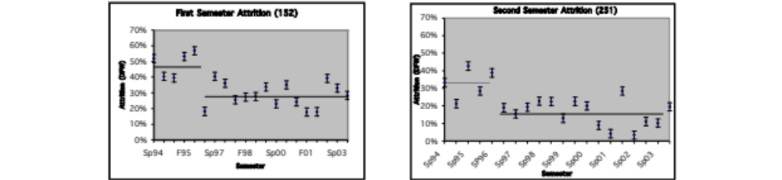
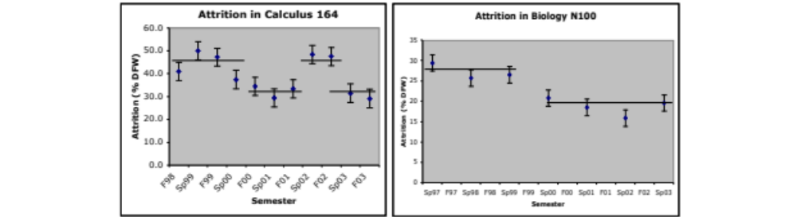
Retention (N~80-150/semester)

Slide 30
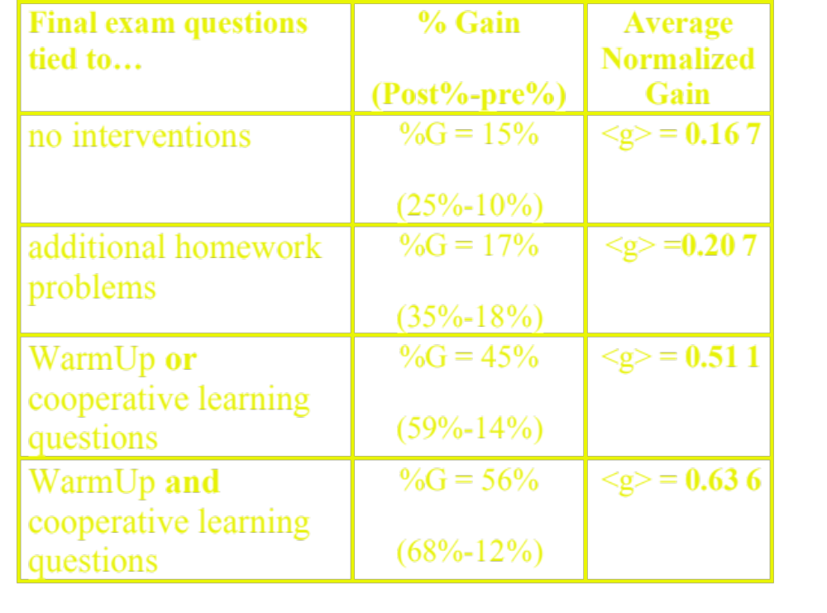
Cognitive (biology, N~200)

Slide 31

Affective (E&M, N~60)

Slide 32
Student Comments
“This was a fantastic course. It was the hardest course I’ve taken yet, but also the most fun.”
I think the WarmUps are a good idea because they give students a chance to think about the material prior to lecture.
"This course was very well structured. It was obvious that a lot of time was spent in preparation for it.”
"152 & 251 have made me reach more than any courses I have taken.”
Don’t tell anyone, but I think I will greatly miss my physics class.

Slide 33
Outline
The Challenges ✓
Just-in-Time Teaching ✓
  Background ✓
  implementation ✓
  Aside: How to get great student evaluations ✓
Assessment ✓
Getting started

Slide 34
Summary
JiTT is based on feedback between homework and classroom
WarmUp exercise: a pre-class, online reading quiz
Improved study habits, retention, content knowledge, morale.
Instructor knowledge of student difficulties
Easily adopted and adapted

Slide 35
Getting started:
Use the handout to start developing a warmup exercise for the course you are most likely to teach next fall
Additional copies will be available online

Slide 37
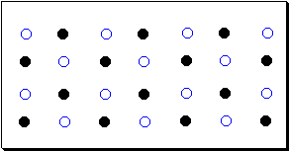
Chemistry example
This picture depicts matter at the submicroscopic level. Describe what you see and take a guess as to what the identity of the substance is.
  “The particles are well spaced out so I would guess the substance to be a gas. The substance is a gas composed of 2 elements that are in an equal ratio.”
  “After reading Chapter 1 in the book I would guess that the substance is water in the form of a solid because the atoms are in order. However, I could be wrong because I think the atoms in a solid might be closer together.”

